Slide 1
Introduction to Data Engineering with GCP

Slide 2
Revision History
Version | Date | Author | Reviewed by | Comments
1.0 | 25-Feb-2025 | Jyothi Shivakumar |  | Initial Version

Slide 3
Explain what is Data Engineering?
Describe roles and responsibilities of Data Engineer
Explain Data Lifecycle
Differentiate between SQL and NoSQL Databases
Select correct GCP data services

Slide 4

Introduction to Data Engineering

Slide 5
What is Data Engineering?
Definition By Google:
A Professional Data Engineer enables data-driven decision making by collecting, transforming, and publishing data
A Data Engineer should be able to design, build, operationalize, secure, and monitor data processing systems with a particular emphasis on security and compliance; scalability and efficiency; reliability and fidelity; and flexibility and portability
A Data Engineer should also be able to leverage, deploy, and continuously train pre-existing machine learning models
In Simple words : Focuses directly on the transportation, transformation, and storage of data.
Notes:
Security and Compliance: A Data Engineer should make sure that the data processing systems they build are secure and comply with any relevant regulations or policies.
Scalability and Efficiency: Data Engineers need to create systems that can handle increasing amounts of data as the organization grows. They design systems that can scale up easily and efficiently without sacrificing performance.
Reliability and Fidelity: Data Engineers focus on building systems that are reliable, meaning they can consistently perform their tasks without errors or interruptions. They also prioritize maintaining data fidelity, which means ensuring the accuracy, consistency, and integrity of the data throughout
Flexibility and Portability: Data Engineers aim to design systems that are flexible and adaptable to changing business needs. They build solutions that can accommodate different data formats, sources, and technologies.
https://cloud.google.com/certification/data-engineer

Slide 6
Role of a data engineer
A data engineer builds data pipelines to enable data-driven decisions
Get the data where it can be useful
Get the data into a usable condition
Add new value to the data
Manage the data
Productionize data process

Slide 7
Role of a data engineer
Roles and Responsibilities
Work On Data Architectures
Data acquisition
Design & Develop data processing systems
Use tools to Analyze the data
Conduct research for industry and business operations
Use large data sets to address business issues
Find hidden patterns using data
Visualize/Present the data
Ensure Security and reliability of data
Notes:
Work On Data Architectures: Data engineers design and create the structures, frameworks, and systems that organize and manage data effectively and efficiently.
Data Acquisition: Data engineers collect and gather data from various sources such as databases, APIs, files, or streaming platforms to make it available for analysis and processing.
Design & Develop Data Processing Systems: Data engineers build and develop systems and pipelines that transform and process data, ensuring its quality, integrity, and compatibility with downstream applications.
Use Tools to Analyze the Data: Data engineers utilize various tools and technologies such as SQL, programming languages, and data processing frameworks to extract insights and perform data analysis tasks on the collected data.
Conduct Research for Industry and Business Operations: Data engineers engage in research activities to understand industry trends, business requirements, and operational needs, in order to design data solutions that align with organizational goals.
Use Large Data Sets to Address Business Issues: Data engineers leverage large volumes of data to identify patterns, trends, and anomalies that help solve complex business problems and improve decision-making processes.
Find Hidden Patterns Using Data: Data engineers apply data mining techniques, statistical analysis, and machine learning algorithms to discover hidden patterns, correlations, and insights that may not be apparent at first glance.
Visualize/Present the Data: Data engineers create visualizations, dashboards, and reports to communicate data findings effectively, enabling stakeholders to understand and interpret the information easily.
Ensure Security and Reliability of Data: Data engineers implement security measures, data privacy protocols, and data governance practices to protect sensitive information, ensure compliance with regulations, and maintain the reliability and availability of data systems.

Slide 8
Data Engineering Challenges

Slide 9




Data Engineering Challenges
Data accuracy and quality
Availability of computational resources
Query performance
Access to data
Notes:
Data architecture is composed of models, policies, rules or standards that govern which data is collected, and how it is stored, arranged, integrated, and put to use in data systems and in organizations.

Slide 10

Data Engineering Challenges
Challenge: Consolidating disparate datasets, data formats, and manage access at scale
Access to data
Notes:
Data architecture is composed of models, policies, rules or standards that govern which data is collected, and how it is stored, arranged, integrated, and put to use in data systems and in organizations.

Slide 11

Data Engineering Challenges
Getting insights across multiple datasets is difficult without a data lake
Data is scattered across Google Analytics 360,Campaign manager products,among other sources
No common tool exists to analyze data and share results with rest of the organisation
Customer and sales data is stored in a CRM system
Some data is not in a queryable format
Notes:
Data architecture is composed of models, policies, rules or standards that govern which data is collected, and how it is stored, arranged, integrated, and put to use in data systems and in organizations.

Slide 12
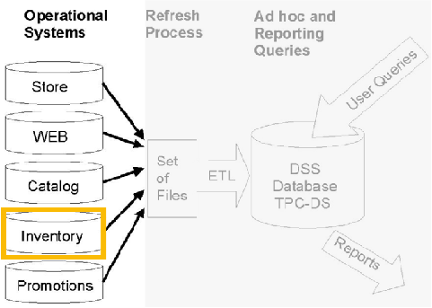
Data Engineering Challenges
Data is often siloed in many upstream source systems
Stored in a separate system and restricted access

Slide 13
Data Engineering Challenges
Challenge: Cleaning, formatting, and getting the data ready for useful business insights in a data warehouse
Data accuracy and quality
Notes:
Data architecture is composed of models, policies, rules or standards that govern which data is collected, and how it is stored, arranged, integrated, and put to use in data systems and in organizations.

Slide 14
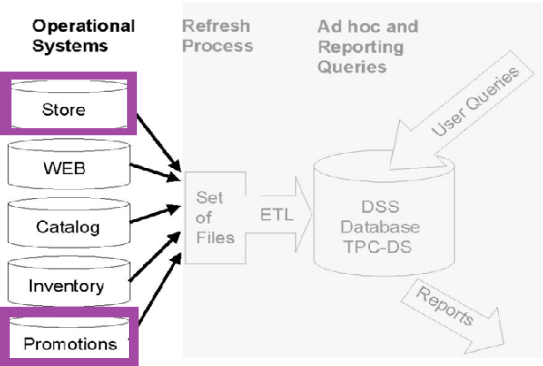
Missing data and time stamp stored in UTC
Data Engineering Challenges
Assume that any raw data from source systems needs to be cleaned and transformed and stored in a data warehouse Query: Give me the best performing in- store promotions in France
Promotion list stored as .csv files or manual spreadsheets

Slide 15
Data Engineering Challenges
Challenge: Ensuring you have the compute capacity to meet peak-demand for your team
Availability of computational resources
Notes:
Data architecture is composed of models, policies, rules or standards that govern which data is collected, and how it is stored, arranged, integrated, and put to use in data systems and in organizations.

Slide 16
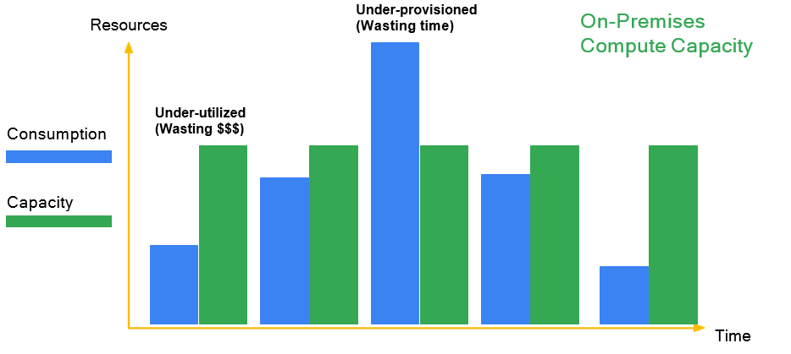
Data Engineering Challenges
Challenge: Data Engineers need to manage server and cluster capacity if using on-premise

Slide 17
Data Engineering Challenges
Challenge: Queries need to be optimized for performance (caching, parallel execution)
Query performance
Notes:
Data architecture is composed of models, policies, rules or standards that govern which data is collected, and how it is stored, arranged, integrated, and put to use in data systems and in organizations.

Slide 18
Data Engineering Challenges
Challenge: Managing query performance on-premise comes with added overhead
Choosing a Query Engine
Continually patching and updating query engine software
Managing clusters and when to re-cluster
Optimize for concurrent queries and quota / demand between teams
Is there a better way to manage server overhead so we can focus on insights?
Notes:
Challenge: On-premise data environments require additional effort to optimize query performance due to factors like hardware limitations, resource allocation, and network latency.
Data engineers need to select the right query engine, such as Apache Spark, Apache Hive, or Presto, based on the specific requirements of the data workload, data volume, and desired performance characteristics.
Data engineers are responsible for regularly updating and patching the query engine software to ensure it remains secure, stable, and compatible with the evolving data ecosystem.
Data engineers must manage and monitor clusters, which are collections of compute resources, and decide when to scale up or down the clusters based on workload demands, data volume, and processing requirements.
Data engineers need to optimize the query engine's configuration and resource allocation to efficiently handle concurrent queries from multiple teams, ensuring fair allocation of resources and preventing performance bottlenecks.

Slide 19
Data Lakes and Data Warehouses

Slide 20
Data Lakes
A data lake is a centralized repository designed to store, process, and secure large amounts of structured, semi structured, and unstructured data
Frequently used to refer to the data collected in a big data system which might be unstructured and frequently changing
Ready to Analyze data
Up to date data, may require advanced tools to analyze data
Flexible
Highly accessible and quick to update data
General Users- Data Scientists
Example : Google cloud storage

Slide 21
Data Warehouses
A data warehouse is an enterprise system used for the analysis and reporting of structured and semi-structured data from multiple sources
Can store both current and historical data in one place and is designed to give a long-range view of data over time
Acts as a primary component of business intelligence
Data is available in warehouse is in ready to use format
Rigid data
More complicated and costly to make changes to data
General Users – Business Professionals
Example – GCP BigQuery

Slide 22


Data Warehouses
A data warehouse stores transformed data in a usable condition for business insights
Extract, Transform, Load Pipeline
Replicate
Raw Data
Data Warehouse
Data Lake
What are the key
considerations when deciding between data warehouse options?

Slide 23
Data Warehouses
Considerations when choosing a data warehouse include:
Can it serve as a sink for both batch and streaming data pipelines?
Can the data warehouse scale to meet my needs?
How is the data organized, cataloged, and access controlled?
Is the warehouse designed for performance?
What level of maintenance is required by our engineering team?
Extract, Transform, Load Pipeline
Data Warehouse
Notes:
Batch and Streaming Data Pipelines: Consider the ability of the data warehouse option to handle both batch and streaming data pipelines. Look for solutions that can seamlessly integrate with data ingestion tools like Google Cloud Dataflow or Apache Beam to process real-time data alongside batch data.
Scalability: Evaluate the scalability capabilities of the data warehouse option. Look for solutions that can easily scale up or down to handle growing data volumes and increasing query loads. Google BigQuery, for example, offers automatic scaling to dynamically allocate resources based on workload demands.
Cataloged and Access Controlled: Consider the ability to catalog and access control the data within the data warehouse. Look for options that provide metadata management features, allowing you to organize and categorize your data assets effectively. Additionally, robust access control mechanisms are crucial for enforcing security and compliance requirements.
Performance: Evaluate the performance characteristics of the data warehouse option. Look for solutions that can provide fast query response times and handle complex analytical workloads efficiently. Consider features like intelligent query optimization, columnar storage, and indexing capabilities.
Maintenance: Consider the level of maintenance required for the data warehouse option. Managed services like Google BigQuery handle infrastructure provisioning, software updates, and maintenance tasks, allowing you to focus on data analysis rather than managing the underlying infrastructure.
6. Cost: Evaluate the cost implications of the data warehouse option. Consider factors such as storage costs, data processing costs, and any additional charges for features like data transfer or advanced analytics. Choose an option that aligns with your budget and cost expectations.

Slide 24
Transactional Databases vs Data Warehouses
OLTP vs OLAP
OLTP Systems(Trasactional)
OLAP Systems(Datawarehouse)
Online Transaction Processing systems
Captures, stores, and processes data from transactions in real time
Based on INSERT, UPDATE, DELETE commands
Control and run essential business operations in real time
Standardized and simple queries
Backup is taken regularly to ensure business continuity
Example – Cloud Firestore
Online Analytical Processing systems
uses complex queries to analyze aggregated historical data from OLTP systems
Based on SELECT commands to aggregate data for reporting
Plan, solve problems, support decisions, discover hidden insights
Complex queries
No regular backup required; lost data can be taken from OLTP database
Example – BigQuery
Notes:
OLTP:

Slide 25

Manage data access and governance
Data Engineering must set and communicate a responsible data governance model
ML Model
Feature Pipeline
Raw Data
Data Lake
Datawarehouse
Other team Data warehouse
Eng Pipeline
BI Pipeline
Who should have access?
How is PII handled?
How can we educate end-users on our data catalog?
Reporting Dashboard
Notes:
PII : Personally Identifiable Information

Slide 26

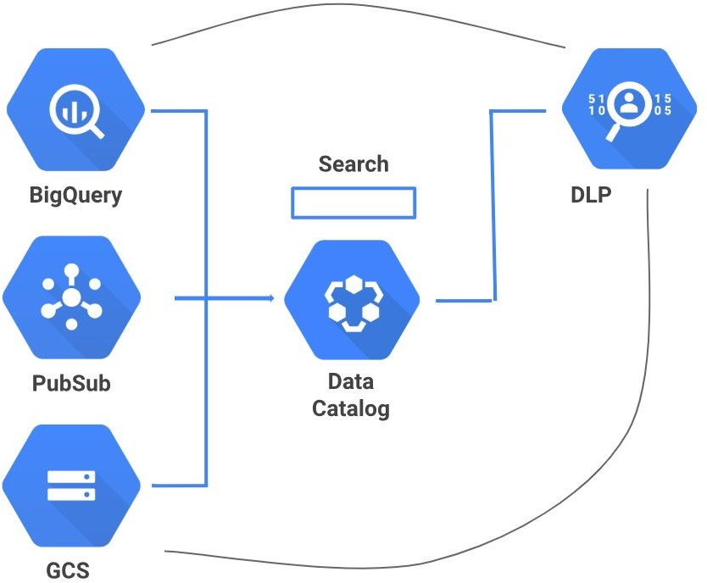
Manage data access and governance
Data catalog
Simplify data discovery at any scale:
Fully managed metadata management service with no infrastructure to set up or manage
Unified view of all datasets:
Central and secure data catalog across Google Cloud with metadata capture and tagging
Data governance foundation:
Security compliance with access level controls along with Cloud Data Loss Prevention integration for handling sensitive data

Slide 27
Data Lifecycle

Slide 28




Data Lifecycle
Ingest
Store
Process and Analyze
Explore and Visualize
Notes:
The data lifecycle has four steps.
Ingest: The first stage is to pull in the raw data, such as streaming data from devices, on-premises batch data, app logs, or mobile-app user events and analytics.
Store: After the data has been retrieved, it needs to be stored in a format that is durable and can be easily accessed.
Process and analyze: In this stage, the data is transformed from raw form into actionable information.
Explore and visualize: The final stage is to convert the results of the analysis into a format that is easy to draw insights from and to share with colleagues and peers.

Slide 29
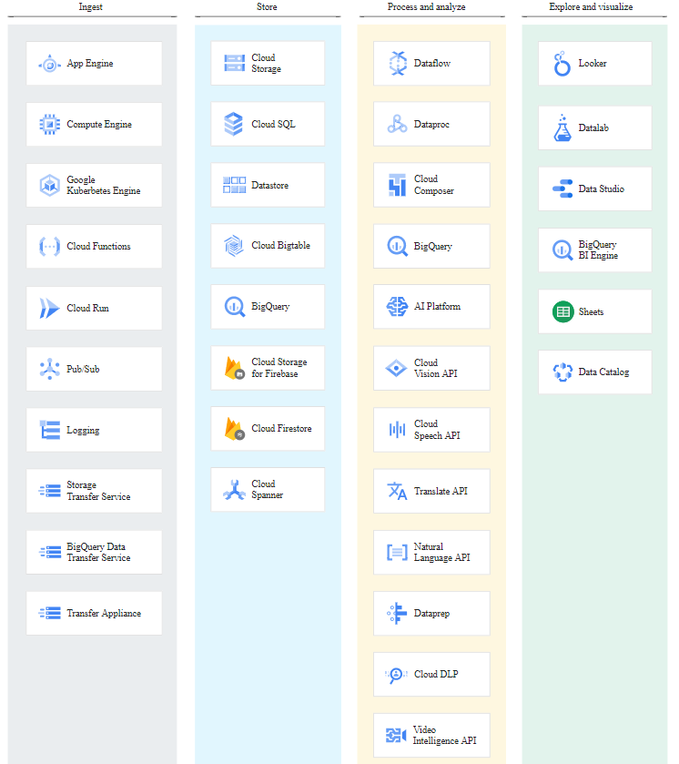
Data Lifecycle in GCP
Google Cloud provides range of services to work with the different data lifecycle stages.

Slide 30
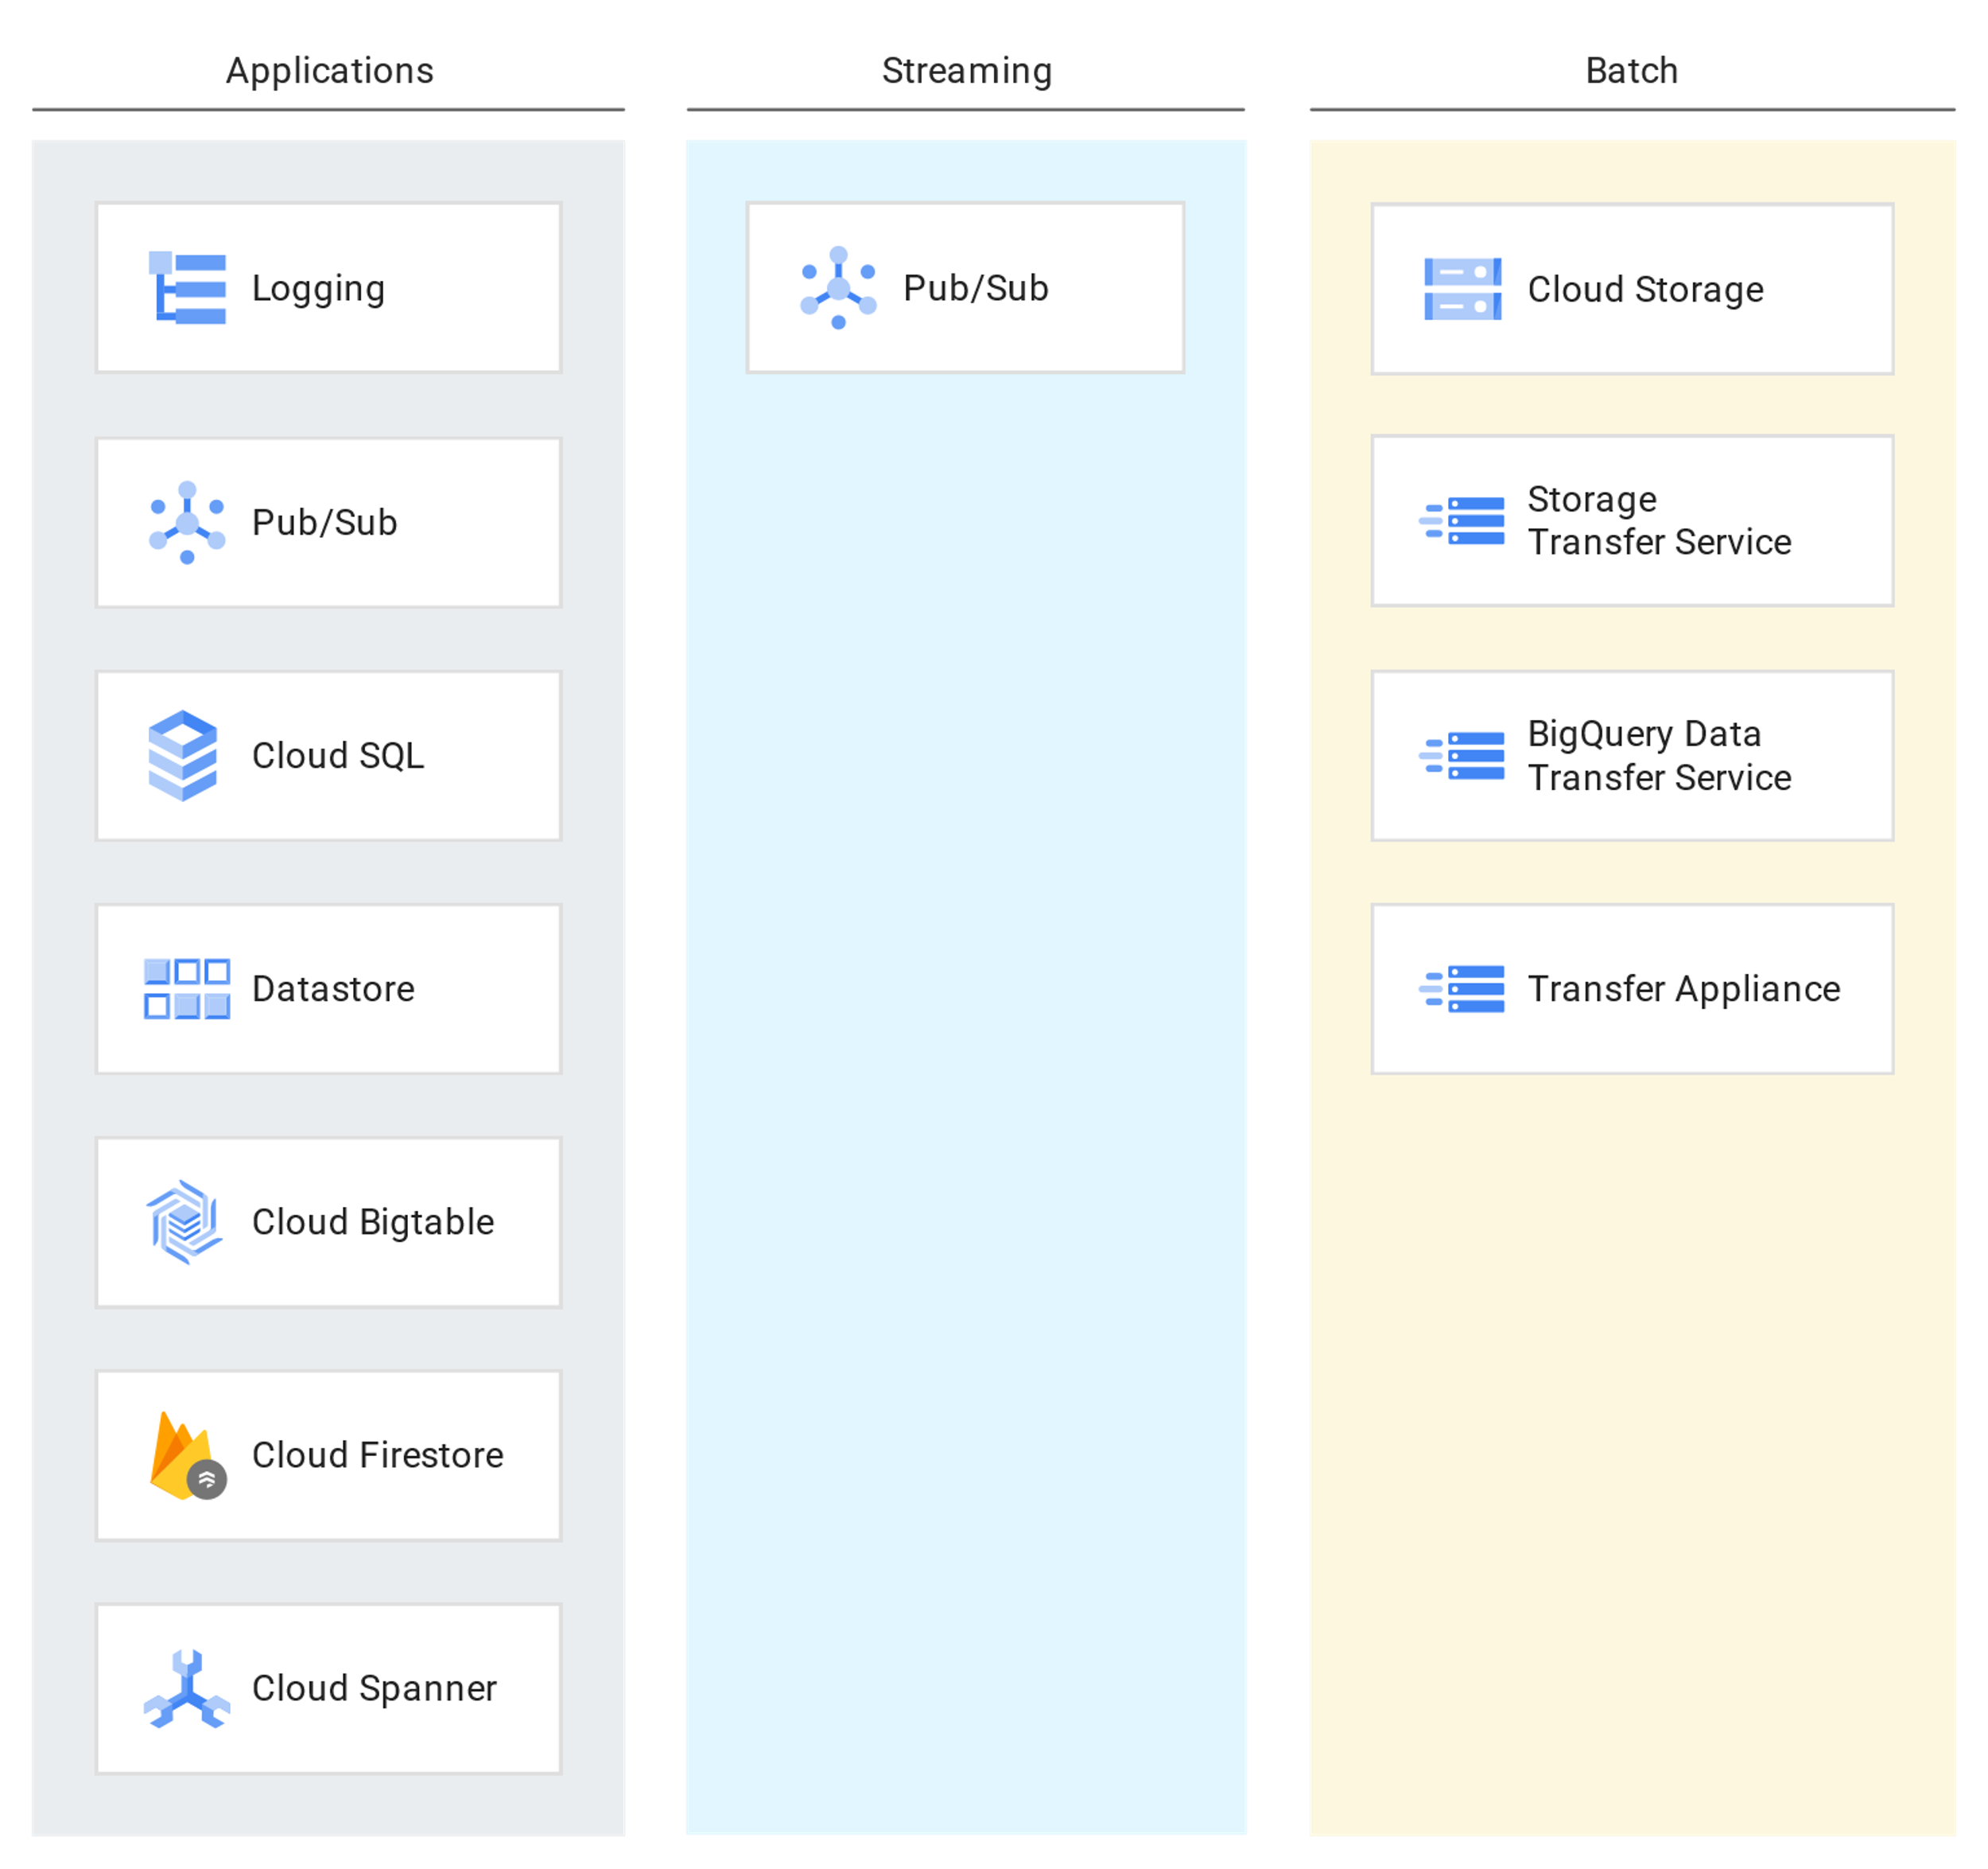
Ingest
Data Can be ingested from:
App
Streaming
Batch
Notes:
App: Data from app events, such as log files or user events, is typically collected in a push model, where the app calls an API to send the data to storage.
Streaming: The data consists of a continuous stream of small, asynchronous messages.
Batch: Large amounts of data are stored in a set of files that are transferred to storage in bulk.

Slide 31
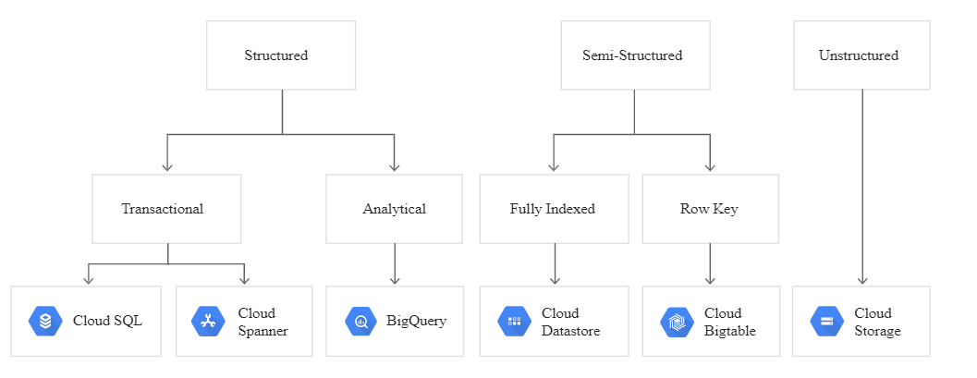
Store
As data can come from different size and sources, ingested data can be stored in variety of formats or locations

Slide 32
Selection of GCP Data Services

Slide 33
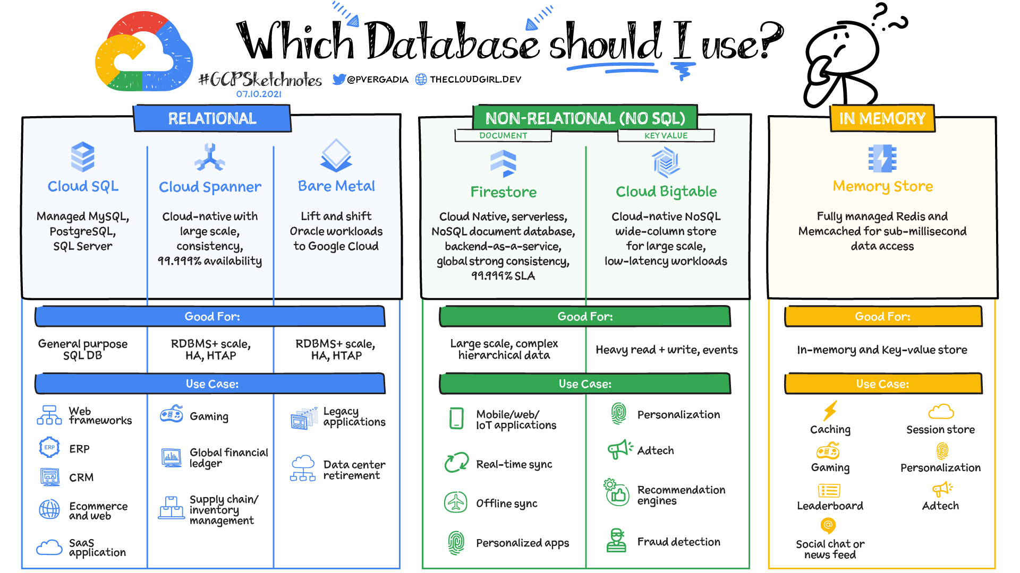
Notes:
HTAP : Hybrid Transactional/Analytical Processing. It refers to a database architecture that combines transactional and analytical processing capabilities within a single system.

Slide 34
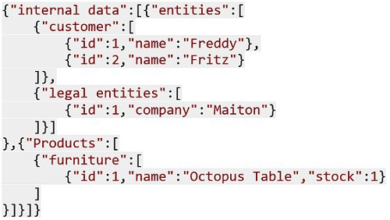
Data Concepts
SQL vs NoSQL
SQL
NoSQL
Relational Databases(RDBMS)
Predefined schemas for structured data
Rigid
Vertically scalable
Tables with fixed rows and columns
Follows ACID property
Example: Customer table
Non-Relational databases/ Distributed databases
Dynamic schema for unstructured data
Flexible, suitable for hierarchical data
Horizontally scalable
JSON documents, key-value pairs, graph
Follows CAP
Example: json document
Custid | CustName | Contact | city
101 | John Smith | Phone | Delhi
Notes:
ACID properties - Atomicity, Consistency, Isolation and Durability
CAP - Consistency, Availability and Partition tolerance

Slide 35
Data Concepts
Batch vs Streaming
Batch Processing
Stream Processing
Data collected over time intervals
The collected batch is sent for processing
Used for Large data processing which is not time sensitive
Data from Legacy systems
Examples:
Payroll
Billing
Orders from customers
Data is collected continuously
Data is processed piece by piece
Stream Processing is fast and provides near real time analytics
Windows and micro-batches
Examples :
Log Monitoring
Fraud detection

Slide 36
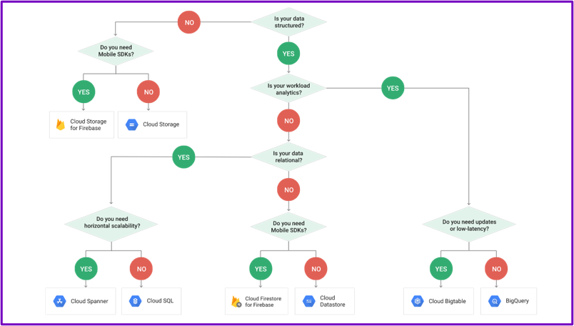
GCP data service selection
Follow the flow diagram to find the correct database choice for your application

Slide 37
Big Data
For Analytical Processing
Data distributed on a cluster with multiple machines
Semi-structured or unstructured data
No random access to data
Data replicated, propagation of updates take time
Different sources may have different unknown formats

Slide 38
3 Vs Of Big Data
Support for 3 V
Volume: Amount of data
Scales to petabytes
Variety: Number and type of sources
Support federated data sources
Cloud storage
BigTable
Google Drive spreadsheets
Velocity: Batch and streaming
Streaming ingestion
Real-time queries

Slide 39
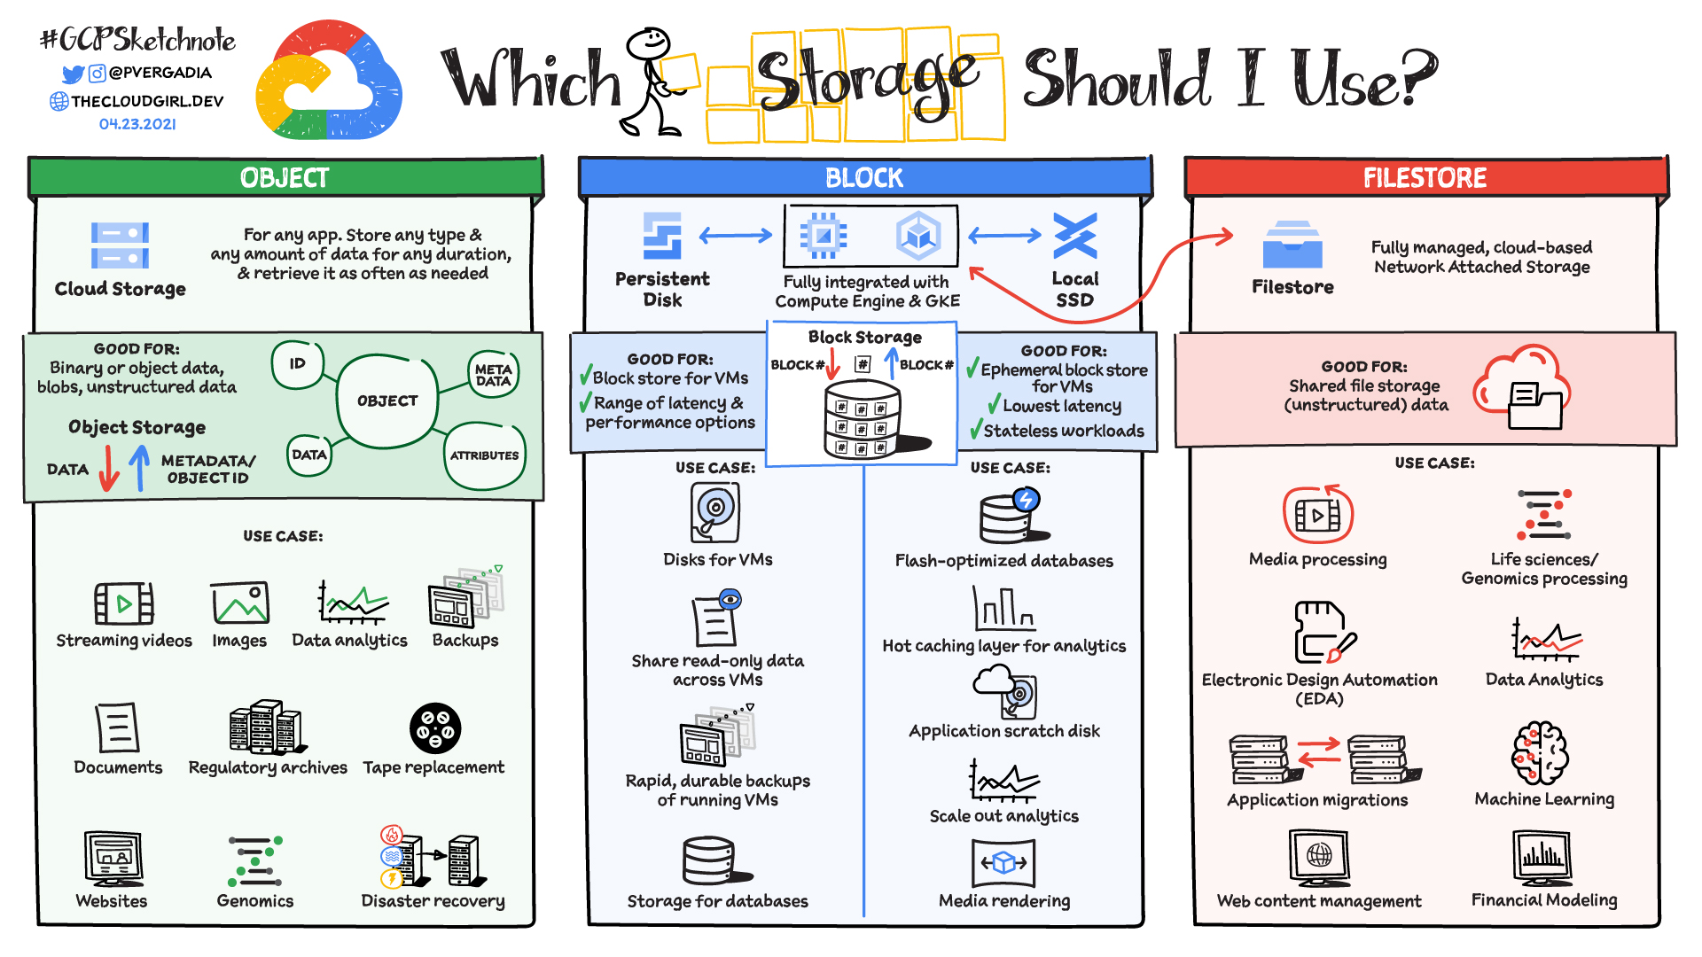

Slide 40
Explain what is Data Engineer?
Describe roles and responsibilities of Data Engineer
Explain Data Lakes and Data Warehouses
Differentiate between Transactional databases and Data Warehouses
Explain Data Lifecycle

Slide 41
Thank You

